Slide 1
DSC 323 – Final Project Wine Dataset
By Corey Jordan-Zamora

Slide 2
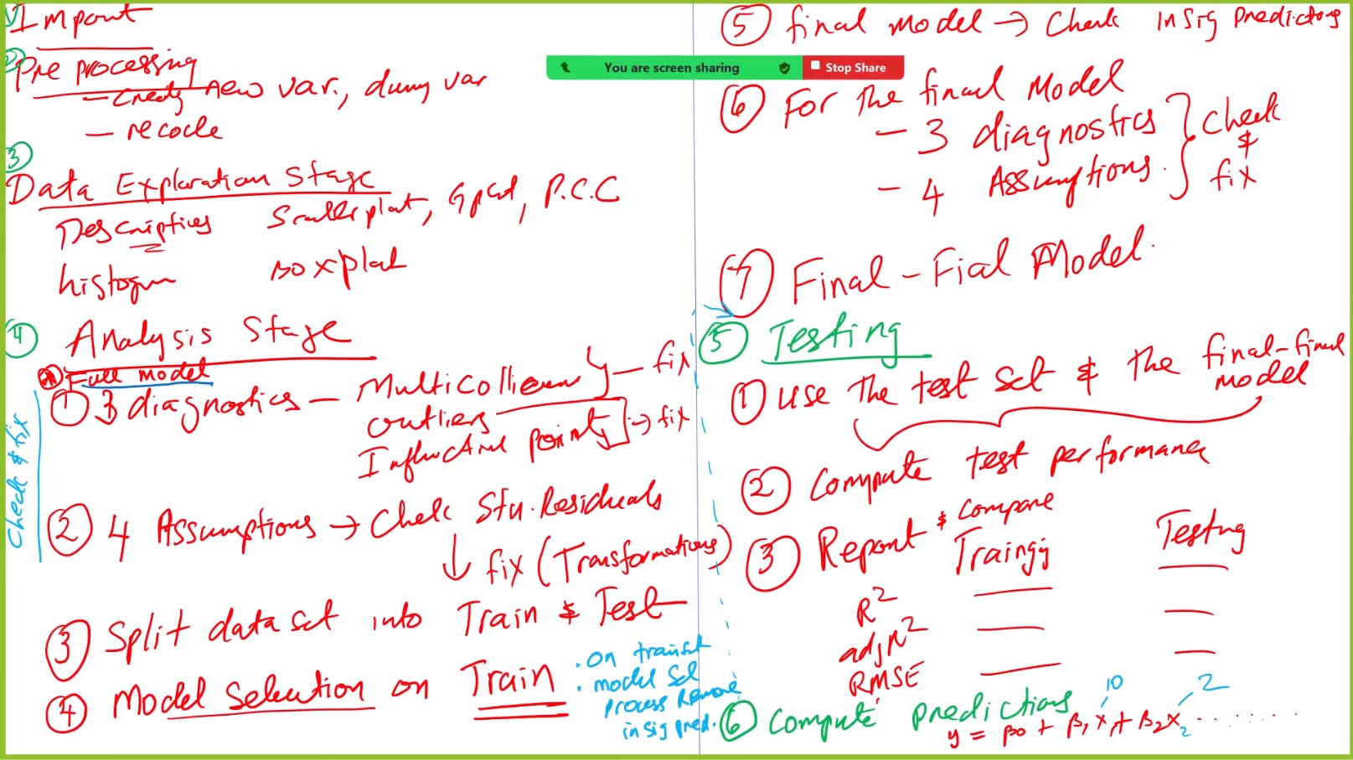
Linear Regression Steps
(Following these steps from Lecture 6):

Slide 3
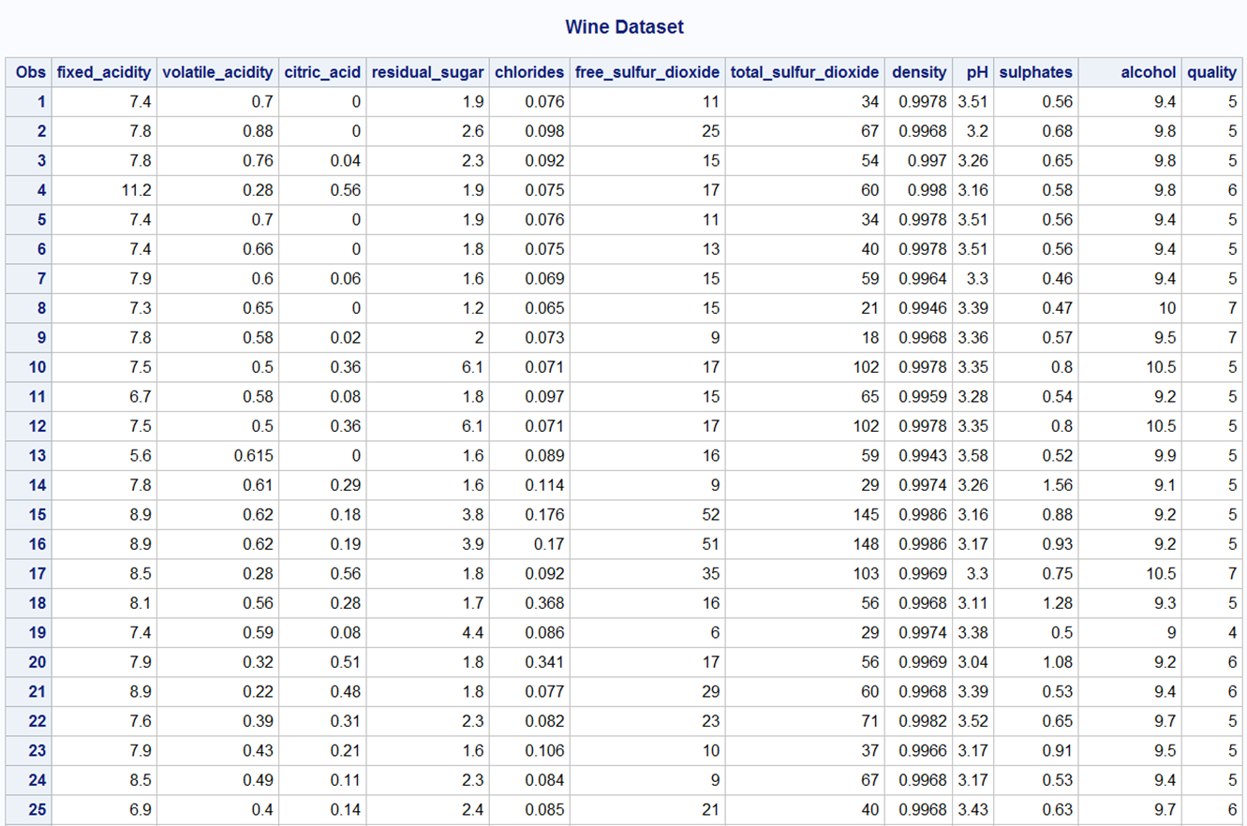

Slide 4
Steps 1 + 2: Import + Pre-processing Stages
Before working with the wine dataset, we have got to import the “wine.txt” file, and perform any pre-processing (creating any dummy variables)
As you can see, there are 11 predictors, and the response variable is quality
There are no dummy variables needed to be created as they are non-categorical.
* ---------------(1 + 2) Import + Pre-processing Stages---------------;
PROC IMPORT datafile = "wine_quality.txt" out = wine replace;
delimiter = '09'x;
getnames = YES;
datarow = 2;
RUN;
TITLE "Wine Dataset";
PROC PRINT;
RUN;

Slide 5
Step 3: Data Exploration Stage
Before embarking on creating a model for the wine dataset, we have got to see if embarking on linear regression is appropriate.
So, we can first see if the data follows a normally distributed pattern by creating a histogram and looking at the descriptives.
* ---------------(3) Data Exploration Stage---------------;
TITLE "Descriptives of Wine Quality";
PROC MEANS n mean min p25 p50 p75 max std stderr;
var quality;
RUN;
TITLE "Histogram of Wine Quality";
PROC UNIVARIATE normal;
var quality;
histogram / normal (mu = est sigma = est);
RUN;

Slide 6
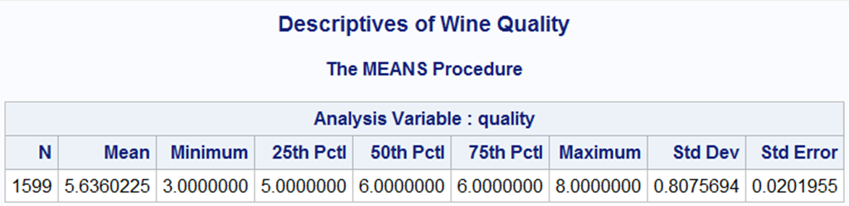
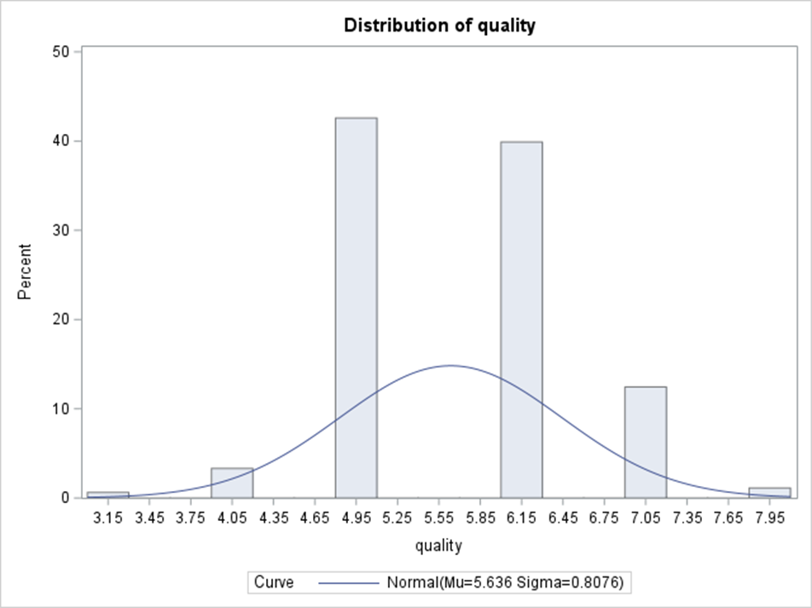
This histogram appears to be normally distributed, albeit with a few gaps, but since it follows that pattern, that makes it linear so far. The lowest wine quality score is 3, and the highest wine quality score is 8. It is symmetric, with the data being centered about the mean of 5.6360225, and the rest of the data deviates by 0.0201955. It appears to be unimodal, but again, does have a few gaps, but I would still not call this data skewed or unusual. So, wine quality seems to follow a normally distributed pattern, therefore no transformation needed (so far, though we will look at the studentized residual of the predicted values to further confirm that).

Slide 7
We can further confirm that linear regression is appropriate by creating a Scatterplot Matrix , as well as a Pearson Correlation Coefficient table, to see if the data follows a linear pattern.
PROC SGSCATTER;
TITLE "Scatterplot Matrix for Wine Data - to See Association";
matrix quality fixed_acidity volatile_acidity citric_acid residual_sugar chlorides free_sulfur_dioxide total_sulfur_dioxide density pH sulphates alcohol;
RUN;
PROC CORR;
TITLE "Correlation Matrix for All Variables - to See Association";
var quality fixed_acidity volatile_acidity citric_acid residual_sugar chlorides free_sulfur_dioxide total_sulfur_dioxide density pH sulphates alcohol;
RUN;

Slide 8
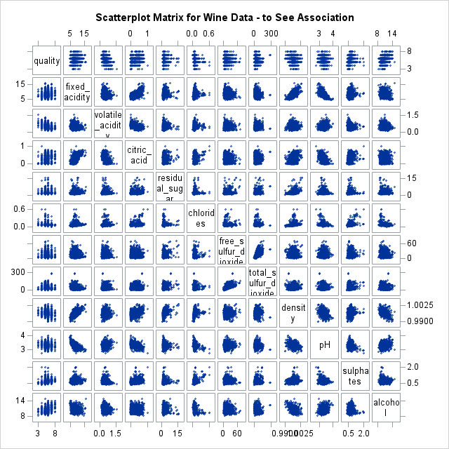
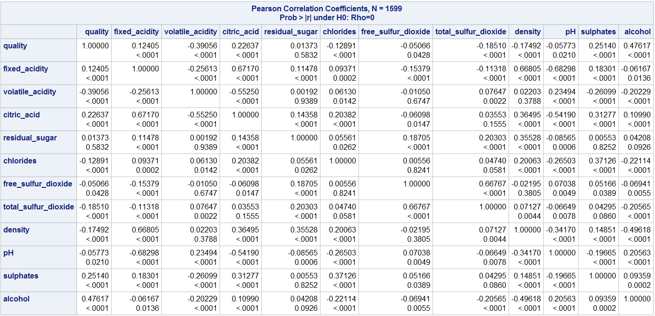

Slide 9
Step 4: Data Analysis Stage
* ---------------(4) Data Analysis Stage---------------;
* This is the full model so far, but we have got to check for the 3 diagnostics (multicollinearity, outliers, and influential points) to refit model as necessary;
* And then check for 4 model assumptions (linearity, constant variance, independence, and normality) on full model;
TITLE "Regression Model 1: Full Model";
PROC REG;
model quality = fixed_acidity volatile_acidity citric_acid residual_sugar chlorides free_sulfur_dioxide total_sulfur_dioxide density pH sulphates alcohol / vif influence r;
plot student.*(fixed_acidity volatile_acidity citric_acid residual_sugar chlorides free_sulfur_dioxide total_sulfur_dioxide density pH sulphates alcohol predicted.);
plot npp.*student.;
RUN;

Slide 10
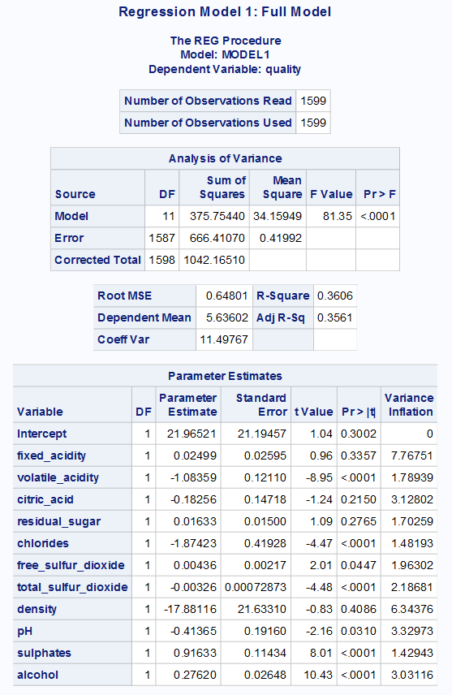
Full Model (M1)
quality = 21.96521 + 0.02499*fixed_acidity – 1.08359*volatile_acidity – 0.18256*citric_acid + 0.01633*residual_sugar – 1.87423*chlorides + 0.00436*free_sulfur_dioxide – 0.00326*total_sulfur_dioxide – 17.88116*density – 0.41365*pH + 0.91633*sulphates + 0.27620*alcohol
There are no highly collinear variables, as their VIF values were not ≥ to 10 (which this is the benchmark for numerically checking for multicollinearity). So, no action necessary to address multicollinearity when there are no highly collinear variables at this point in time [i.e., at this full model point].

Slide 11
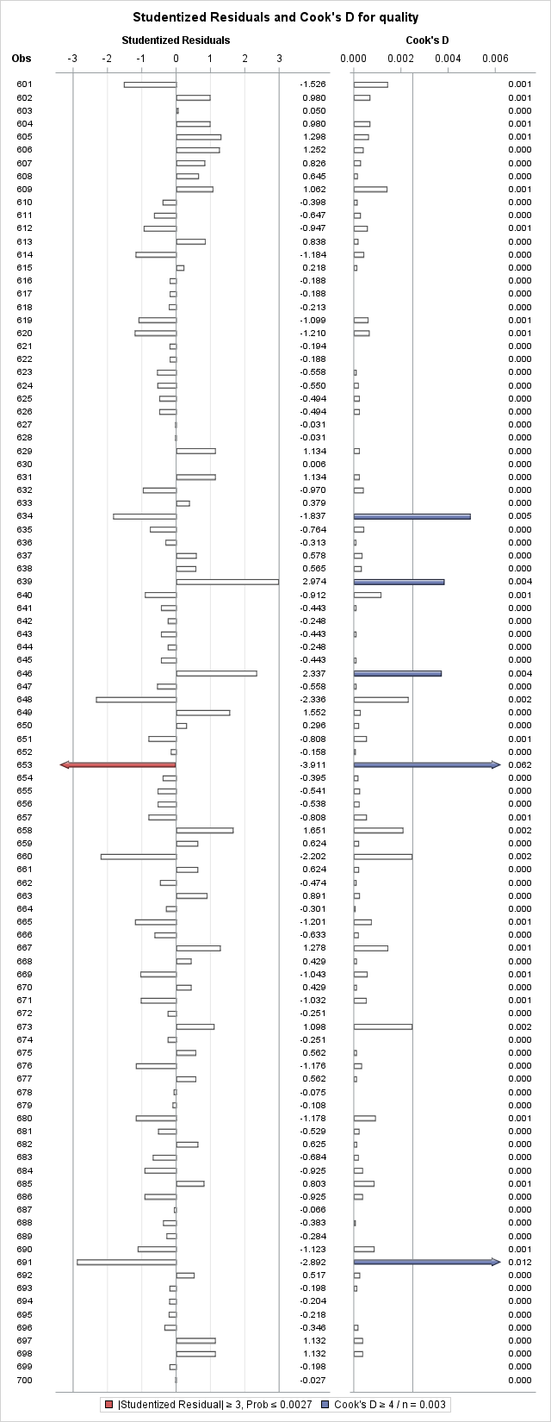
TITLE "Proc Print - After Deleting Outliers and Inf. Points for Model 1";
DATA wine_removed; * Naming the new wine dataset this to indicate that it is the one with the removed observations;
set wine;
* Remove these observations: 46, 93, 152, 162, 282, 354, 391, 410, 441, 456, 460, 481, 653, 691, 724, 833, 834, 862, 900, 1080, 1082, 1091, 1234, 1236, 1277, 1300, 1320, 1375, 1404, 1435, 1436, 1479;
if _n_ in (46, 93, 152, 162, 282, 354, 391, 410, 441, 456, 460, 481, 653, 691, 724, 833, 834, 862, 900, 1080, 1082, 1091, 1234, 1236, 1277, 1300, 1320, 1375, 1404, 1435, 1436, 1479) then delete;
RUN;
TITLE "Proc Print - After Deleting Outliers and Inf. Points for Model 1";
PROC PRINT;
RUN;
* Should have 1567 observations read, since 1599 total - 32 removed = 1567 observations, which we do;
* Now, multicollinearity, outliers, and influential points have been addressed for the full model;
Outliers [marked with arrowheads, means they are extreme points marked by the system] at observations: 653, 833, 1277, 1506
Influential points [marked with arrowheads, means they are extreme points marked by the system] at observations: 46, 93, 152, 162, 282, 354, 391, 410, 441, 456, 460, 481, 653, 691, 724, 833, 834, 862, 900, 1080, 1082, 1091, 1234, 1236, 1277, 1300, 1320, 1375, 1404, 1435, 1436, 1479
Marked as both outliers and influential points with arrowheads: 46, 93, 152, 162, 282, 354, 391, 410, 441, 456, 460, 481, 653, 691, 724, 833, 834, 862, 900, 1080, 1082, 1091, 1234, 1236, 1277, 1300, 1320, 1375, 1404, 1435, 1436, 1479
So I removed the observations that were marked as both, as well as all influential points, because that means they have a high influence on my data or make it skewed.

Slide 12

Can check observations were properly deleted by running a PROC PRINT statement on edited dataset, wine_removed, and also running a PROC REG statement so that you can see the new parameter estimates for the predictors as well as see this output:
Model now becomes M2

Slide 13
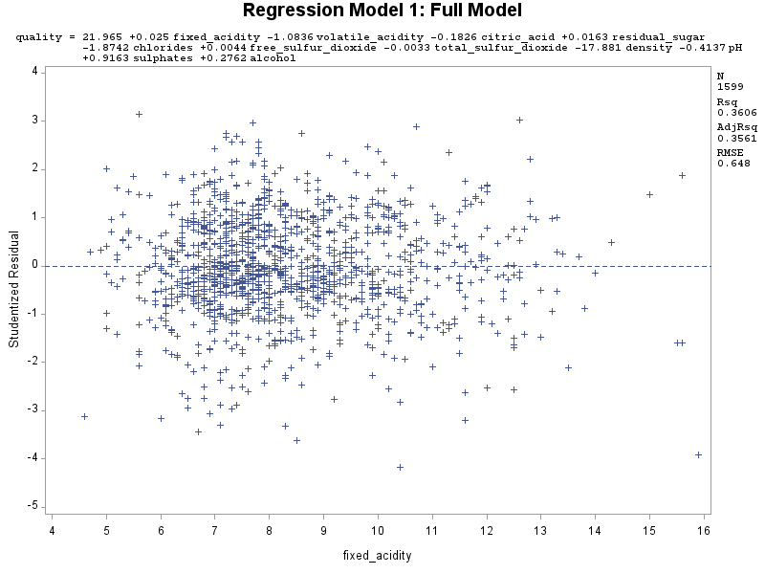
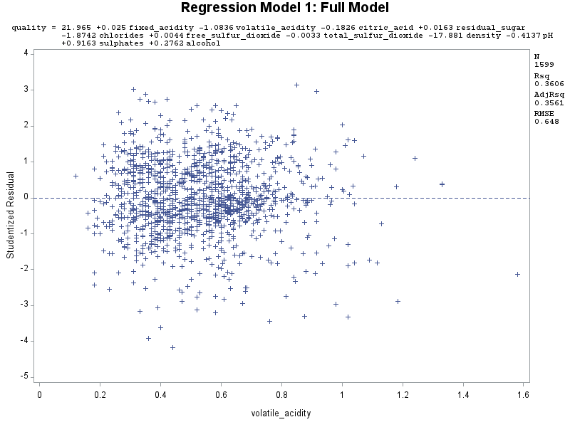
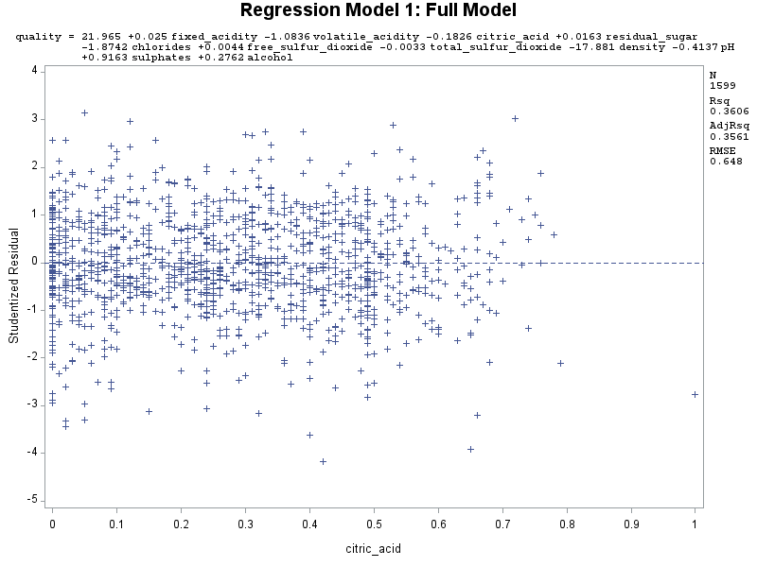
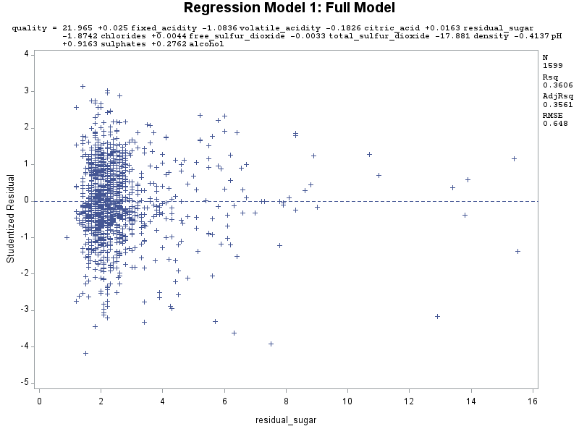
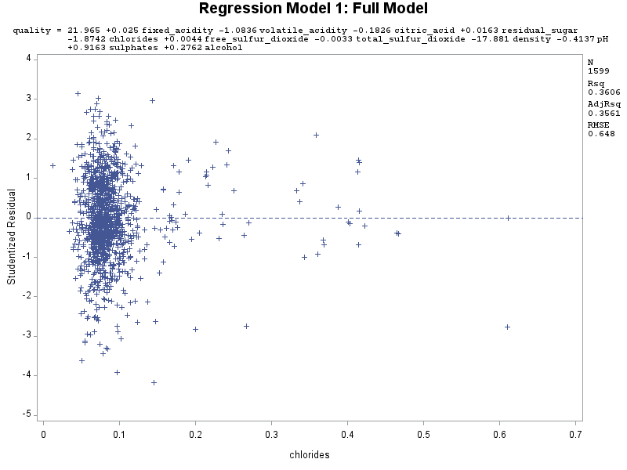
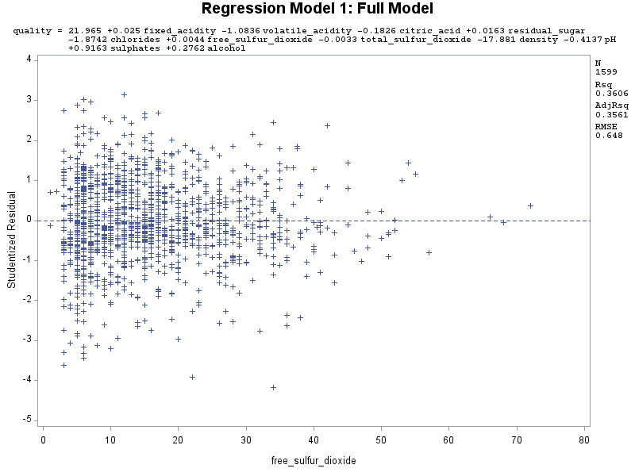
Residuals of Full Model

Slide 14
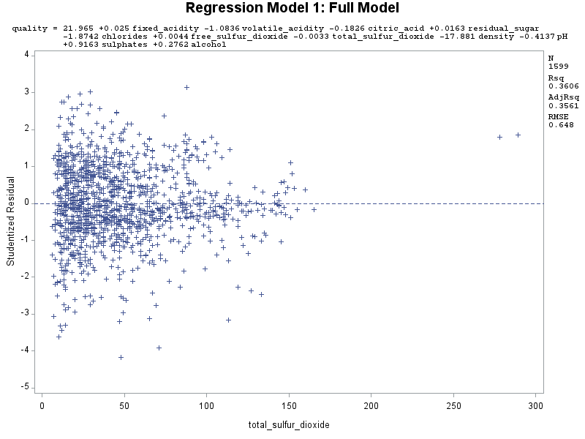
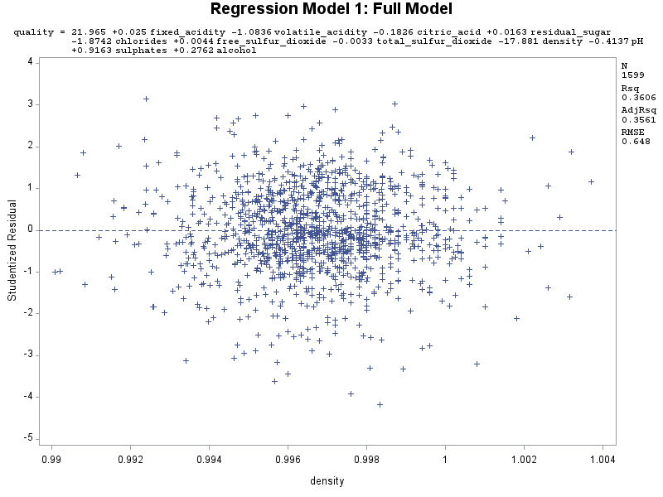
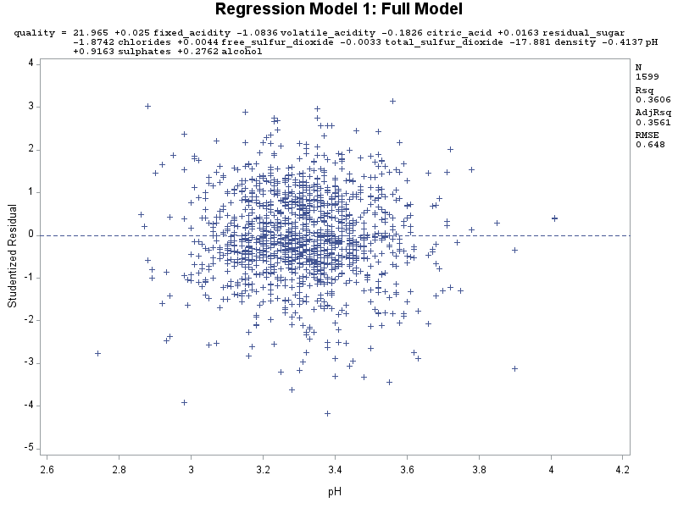
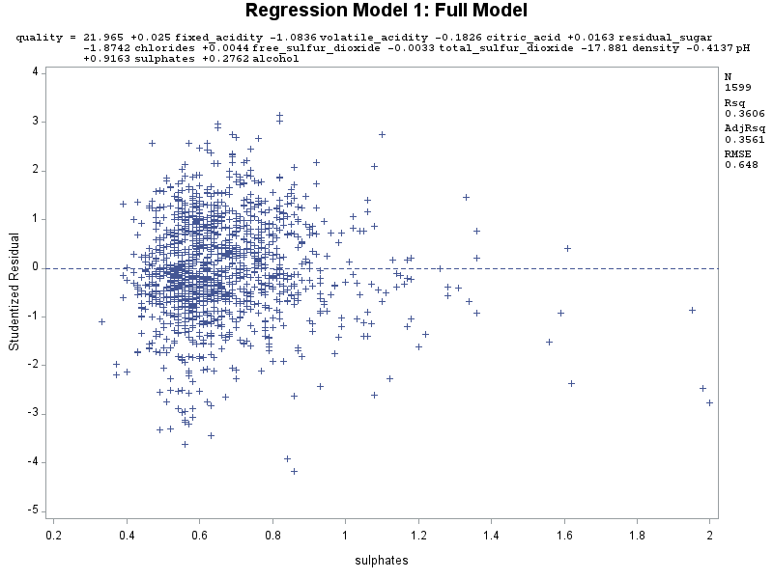
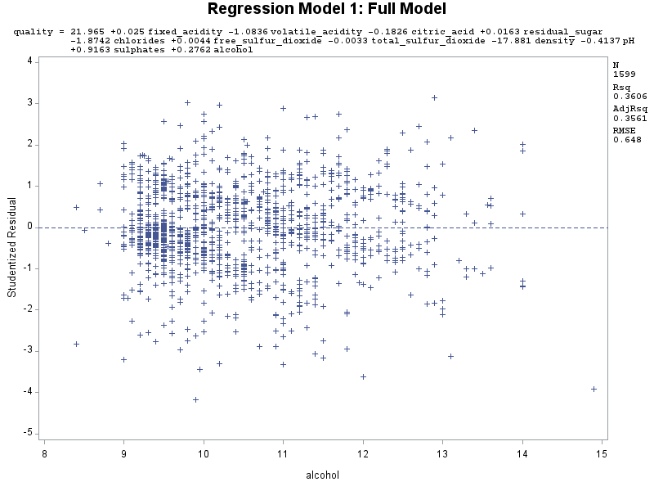

Slide 15
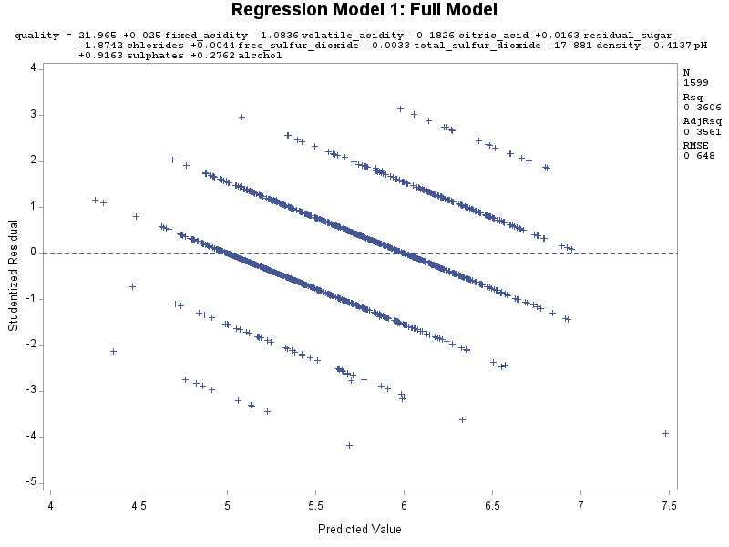
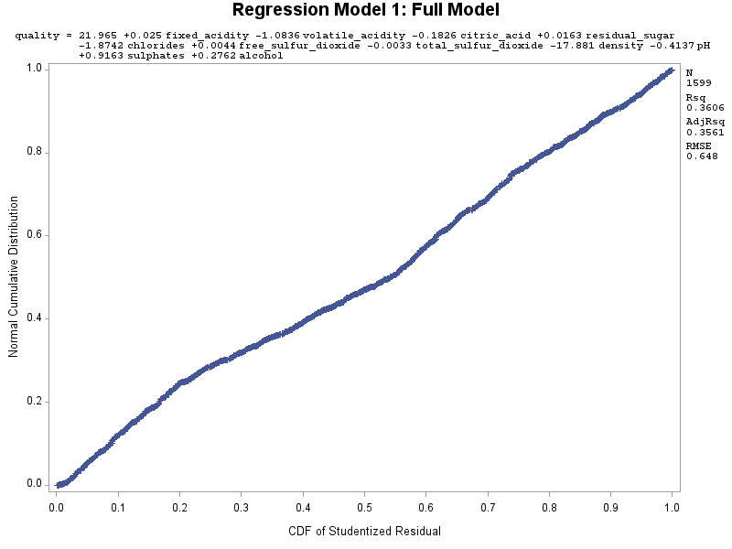

Slide 16
Analysis of Residuals for Full Model
For the residual plots for majority of the predictors, they appear to be randomly scattered around the zero line. However, for the residual plots for residual_sugar and chlorides, they seem to be on the left side, so not randomly scattered all over the place (instead, with this left-pattern). Also, influential points are strikingly apparent in the residuals plots for citric_acid, free_sulfur_dioxide, and total_sulfur_dioxide. For the most part, though, the residual plots satisfy the linearity, constant variance, and independence assumptions.
For the residual plot for the predicted values, the data points appear randomly scatted around the zero line, so it does satisfy constant variance and independence assumptions (and since randomly scattered, no transformation of y-variable, quality, needed at all!).
For the normal probability plot, the shape appears mostly linear to me, but it does look like it can be slightly improved (which we will try to when we get to our final model), but it still satisfies the normality assumption.
Overall, since all assumptions are mostly met (for linearity, constant variance, independence, and normality). (Well, constant variance and independence may be slightly violated with those aforementioned predictors, but the other predictors look good)), that means a regression model is a good fit for the data.

Slide 17
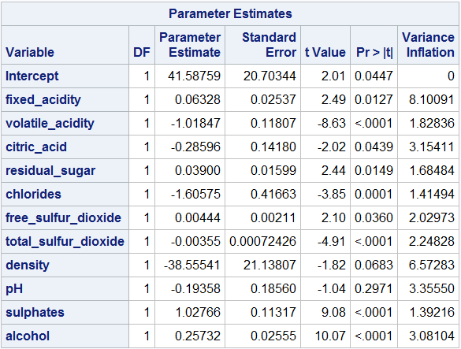
Model 2
* Rerun model without the outliers and influential points - use new wine dataset, wine_removed;
TITLE "Regression Model 2: Full Model w/o Outliers and Influential Points";
PROC REG data = wine_removed;
model quality = fixed_acidity volatile_acidity citric_acid residual_sugar chlorides free_sulfur_dioxide total_sulfur_dioxide density pH sulphates alcohol / vif influence r;
plot student.*(fixed_acidity volatile_acidity citric_acid residual_sugar chlorides free_sulfur_dioxide total_sulfur_dioxide density pH sulphates alcohol predicted.);
plot npp.*student.;
RUN;
quality = 41.58759 + 0.06328*fixed_acidity – 1.01847*volatile_acidity – 0.28596*citric_acid + 0.03900*residual_sugar – 1.60575*chlorides + 0.00444*free_sulfur_dioxide – 0.00355*total_sulfur_dioxide – 38.55541*density – 0.19358*pH + 1.02766*sulphates + 0.25732*alcohol

Slide 18
Splitting of Data between Training and Testing Sets
* Divide data between training and testing sets in order to move forward with creating a proper final model that we can later test (model validation);
* Create a new dataset wine2, which adds a column that shows the splitting of data between training and testing sets;
* Select training set consisting of 75% of cases and testing set with remaining 25% of cases;
* surveyselect defines the "selected" variable that either has a value of 1 for cases in training set, or a value of 0 for cases in testing set, and saves data in the dataset wine2;
* I chose the random seed of 724881 as seen below;
TITLE "Training and Testing Sets for Wine Data";
PROC SURVEYSELECT data = wine_removed out = wine2 seed = 724881
samprate = 0.75 outall; * outall - Shows all the data selected (1) and not selected (0) for training;
RUN;
* Create new variable new_quality = quality for training set, and = NA for testing set;
DATA wine2;
set wine2;
if selected then new_quality = quality; * If selected = 1, assign new_quality = quality;
RUN;
PROC PRINT data = wine2;
RUN;

Slide 19
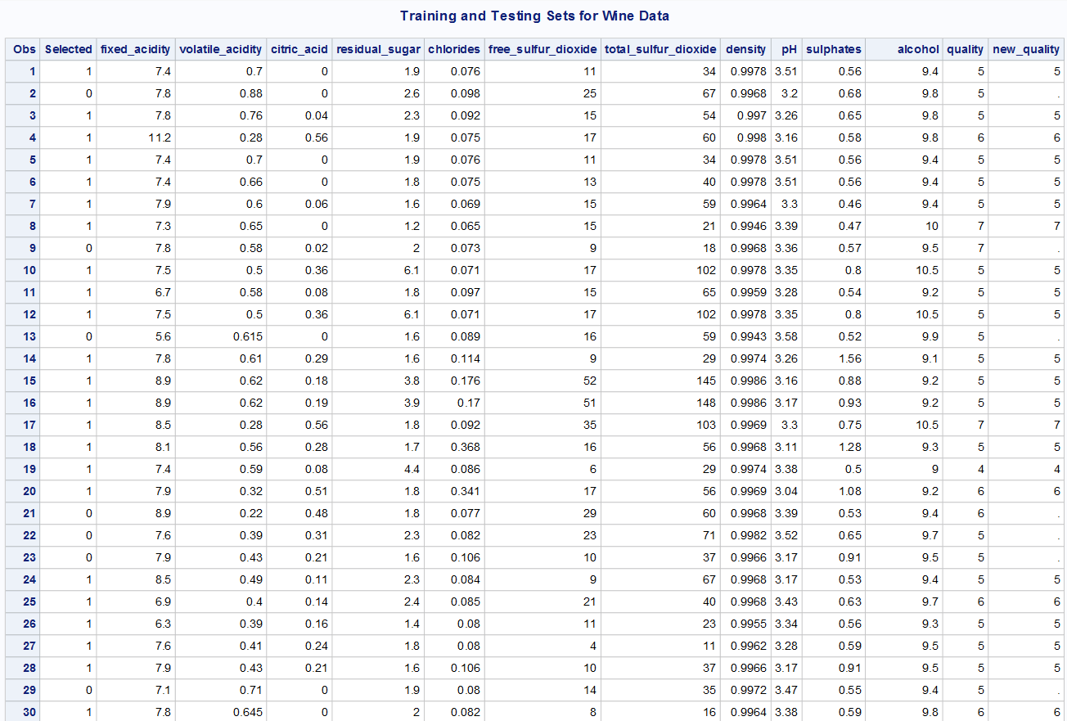
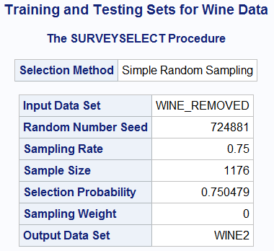

Slide 20
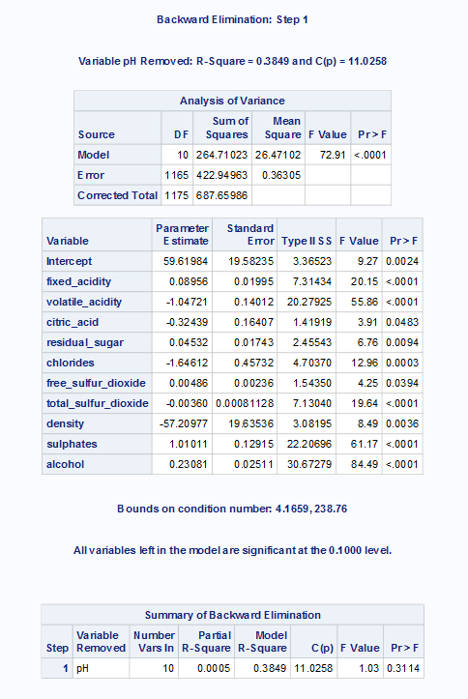
Selection Method 1: Backward Selection Method. Model 3
TITLE "Selection Method 1: Backward Selection Method. Model 3";
PROC REG data = wine2;
model new_quality = fixed_acidity volatile_acidity citric_acid residual_sugar chlorides free_sulfur_dioxide total_sulfur_dioxide density pH sulphates alcohol / selection = backward;
RUN;
* After I ran it, these were the variables left in the model (10 predictors remaining, and 1 variable removed):;
* fixed_acidity, volatile_acidity, citric_acid, residual_sugar, chlorides, free_sulfur_dioxide, total_sulfur_dioxide, density, sulphates, alcohol, so removed pH;
* R^2 value was 0.3849;
Note: Only output of last step (Step 1) since backwards selection starts with all variables, and then removes insig. predictors one-by-one. In this case, only 1 variable, pH, was insignificant, so that is why only up to one step

Slide 21
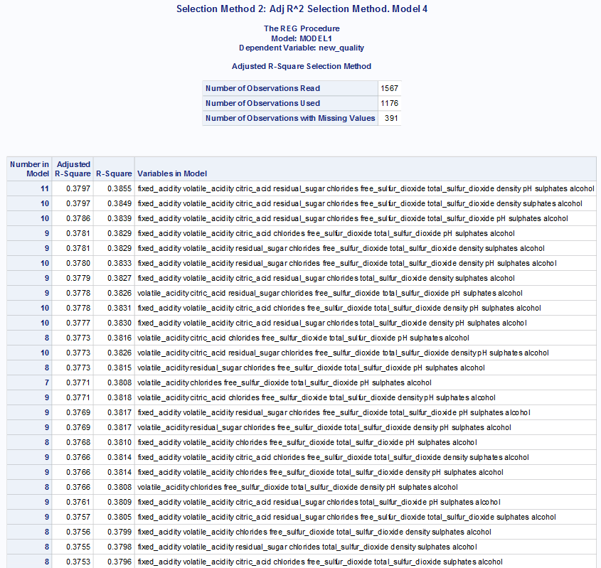
Selection Method 2: Adj R² Selection Method. Model 4
TITLE "Selection Method 2: Adj R^2 Selection Method. Model 4";
PROC REG data = wine2;
model new_quality = fixed_acidity volatile_acidity citric_acid residual_sugar chlorides free_sulfur_dioxide total_sulfur_dioxide density pH sulphates alcohol / selection = adjrsq;
RUN;
/* I chose the second row instead of the first row in the output generated for the adj R^2 selection method, as both rows had the same adj R^2 value,
so it didn't really matter which one I chose,
so I chose row 2 with the one-less predictor as it made more business-sense (one less variable to keep track of).
Also, row 2 had the same R^2 value as the backwards selection method */
* After I ran it, these were the variables left in the model (10 predictors remaining, and 1 variable removed):;
* fixed_acidity, volatile_acidity, citric_acid, residual_sugar, chlorides, free_sulfur_dioxide, total_sulfur_dioxide, density, sulphates, alcohol, so removed pH;
* R^2 value was 0.3849;
* So overall, same model as backwards selection method, and we'll move forward with this model now that has 10 predictors;

Slide 22
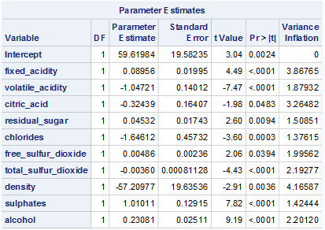
Model 5
TITLE "Regression Model 5";
PROC REG data = wine2;
model new_quality = fixed_acidity volatile_acidity citric_acid residual_sugar chlorides free_sulfur_dioxide total_sulfur_dioxide density sulphates alcohol / vif influence r;
plot student.*(fixed_acidity volatile_acidity citric_acid residual_sugar chlorides free_sulfur_dioxide total_sulfur_dioxide density sulphates alcohol predicted.);
plot npp.*student.;
RUN;
new_quality = 59.61984 + 0.08956*fixed_acidity – 1.04721*volatile_acidity – 0.32439*citric_acid + 0.04532*residual_sugar – 1.64612*chlorides + 0.00486*free_sulfur_dioxide – 0.00360*total_sulfur_dioxide – 57.20977*density + 1.01011*sulphates + 0.23081*alcohol
However, we have got to check for 3 diagnostics and 4 model assumptions again.
Again (as with the full model), we see that there is still no multicollinearity, as no predictor has a VIF value >= 10

Slide 23
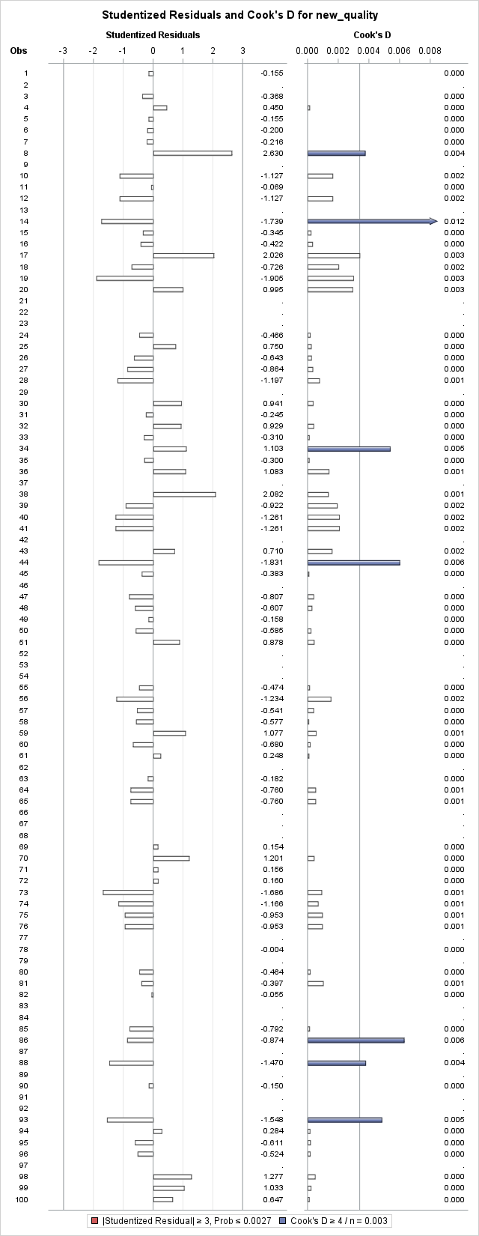
TITLE "Proc Print - After Deleting Outliers and Inf. Points for Model 5";
DATA wine2_removed;
set wine2;
* Remove these observations: 14, 434, 506, 622;
if _n_ in (14, 434, 506, 622) then delete;
RUN;
TITLE "Proc Print - After Deleting Outliers and Inf. Points for Model 5";
PROC PRINT;
RUN;
* Should have 1563 observations read, since 1567 total - 4 removed = 1563 observations, which we do;
* Now, multicollinearity, outliers, and influential points have been addressed for Model 5;

Slide 24
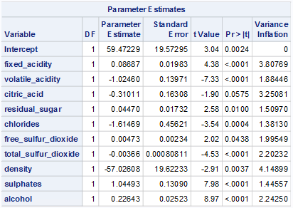
Model 6
* Rerun model without the outliers and influential points - use new wine dataset, wine2_removed; TITLE "Regression Model 6: Adjusted Model 5 w/o Outliers and Influential Points"; PROC REG data = wine2_removed; model new_quality = fixed_acidity volatile_acidity citric_acid residual_sugar chlorides free_sulfur_dioxide total_sulfur_dioxide density sulphates alcohol / vif influence r; plot student.*(fixed_acidity volatile_acidity citric_acid residual_sugar chlorides free_sulfur_dioxide total_sulfur_dioxide density sulphates alcohol predicted.); plot npp.*student.; RUN;
new_quality = 59.47229 + 0.08687*fixed_acidity – 1.02460*volatile_acidity – 0.31011*citric_acid + 0.04470*residual_sugar – 1.61469*chlorides + 0.00473*free_sulfur_dioxide – 0.00366*total_sulfur_dioxide – 57.02608*density + 1.04493*sulphates + 0.22643*alcohol

Slide 25
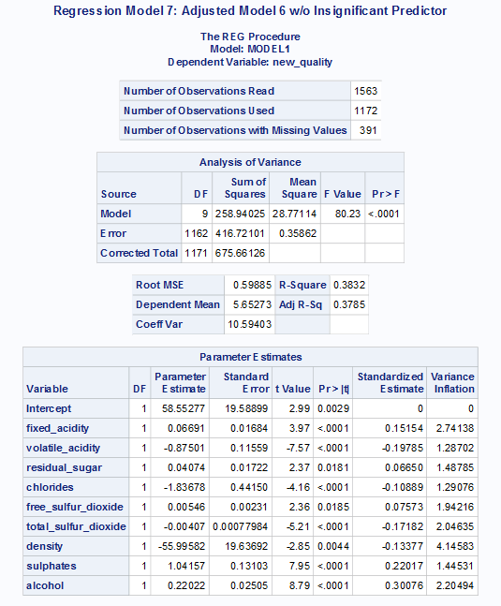
Model 7
* However, after removing those points, I see that citric_acid became insignificant, as its p-value was 0.0575, which is greater than our alpha value at 0.05;
* So, I'm going to remove it from our Model 6, and now our model becomes:;
TITLE "Regression Model 7: Adjusted Model 6 w/o Insignificant Predictor";
PROC REG data = wine2_removed;
model new_quality = fixed_acidity volatile_acidity residual_sugar chlorides free_sulfur_dioxide total_sulfur_dioxide density sulphates alcohol / stb vif influence r;
plot student.*(fixed_acidity volatile_acidity residual_sugar chlorides free_sulfur_dioxide total_sulfur_dioxide density sulphates alcohol predicted.);
plot npp.*student.;
RUN;

Slide 26
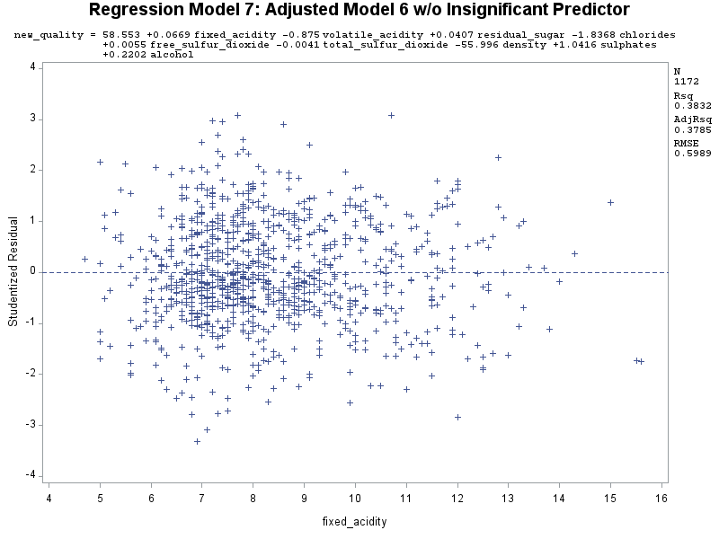
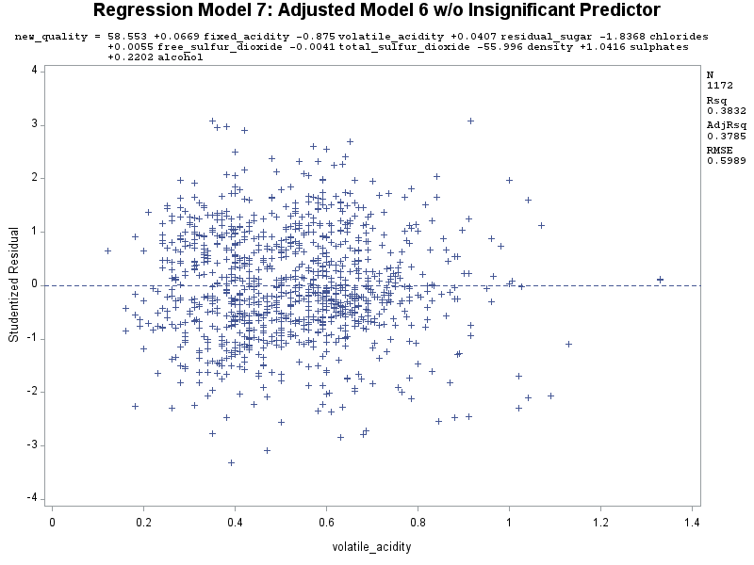
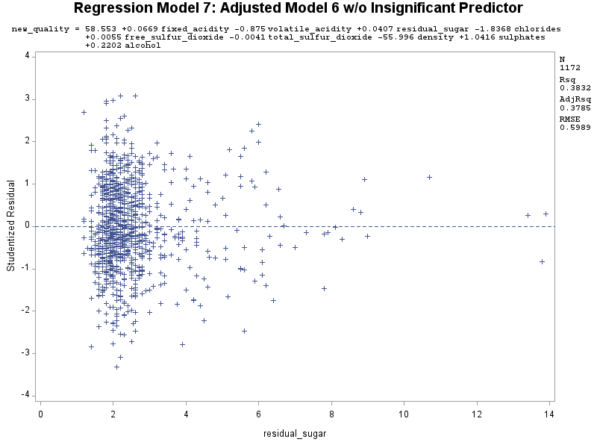
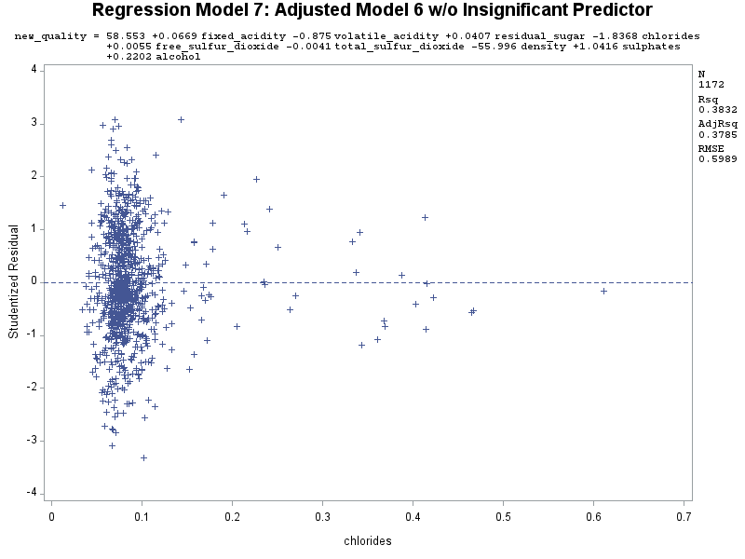
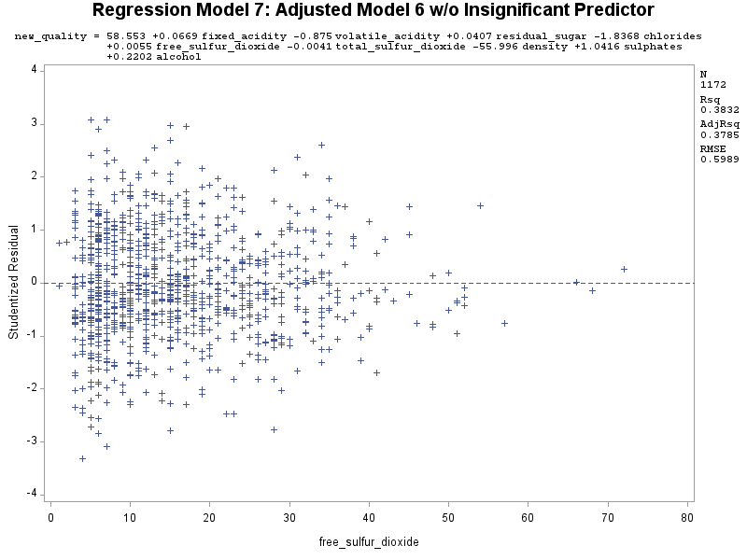
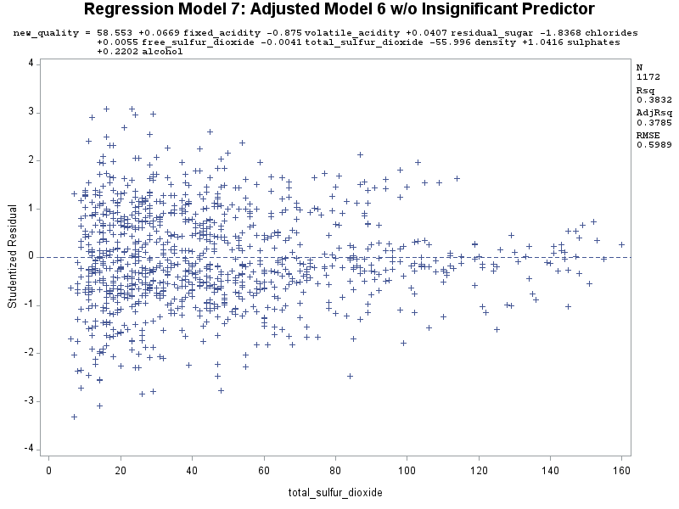
Residuals of Final Model

Slide 27
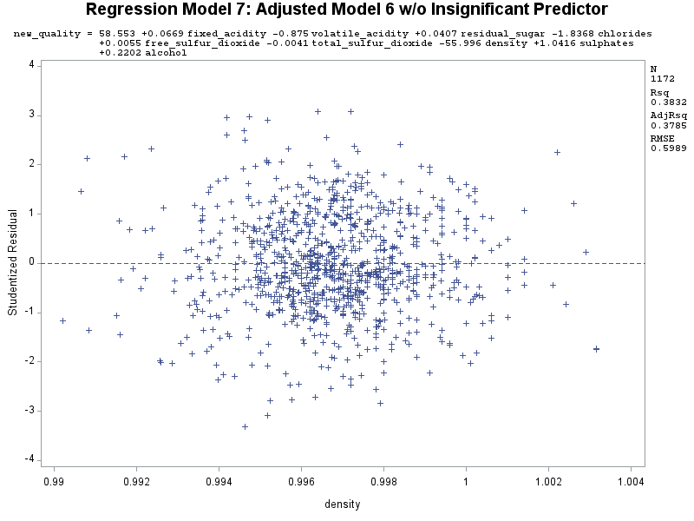
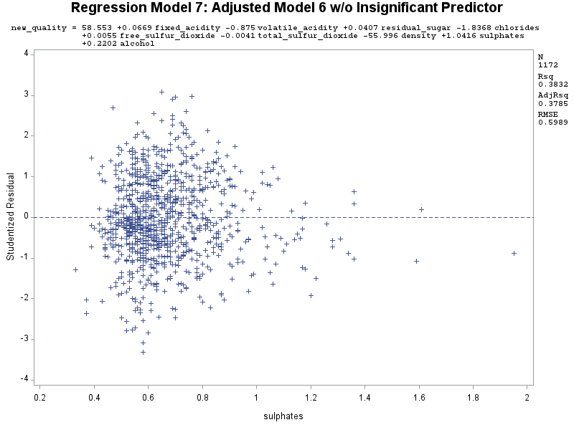
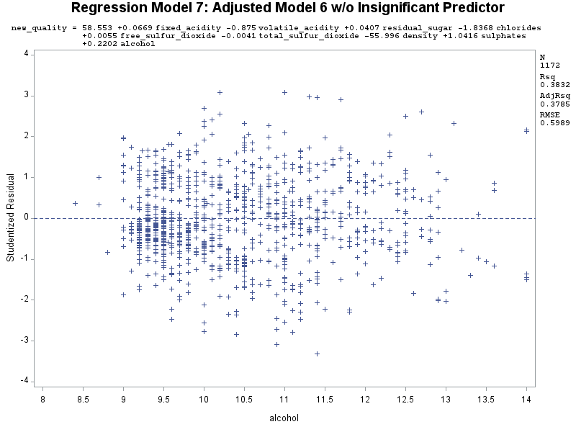
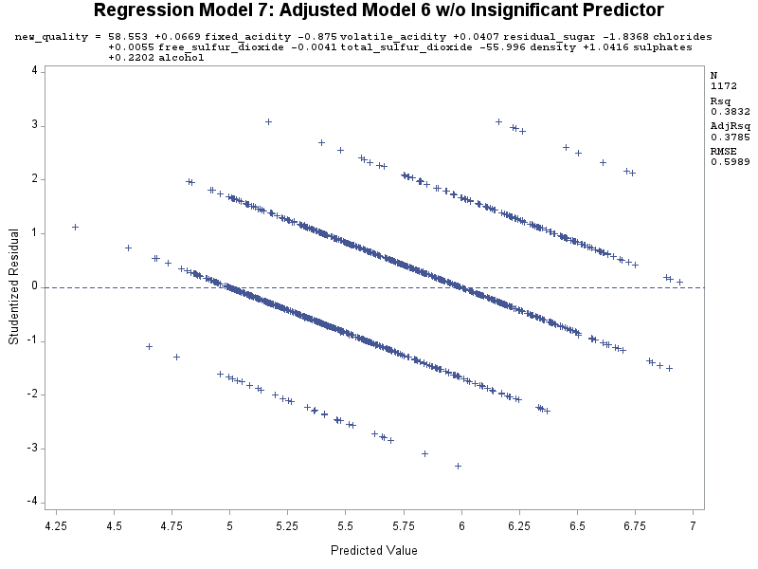
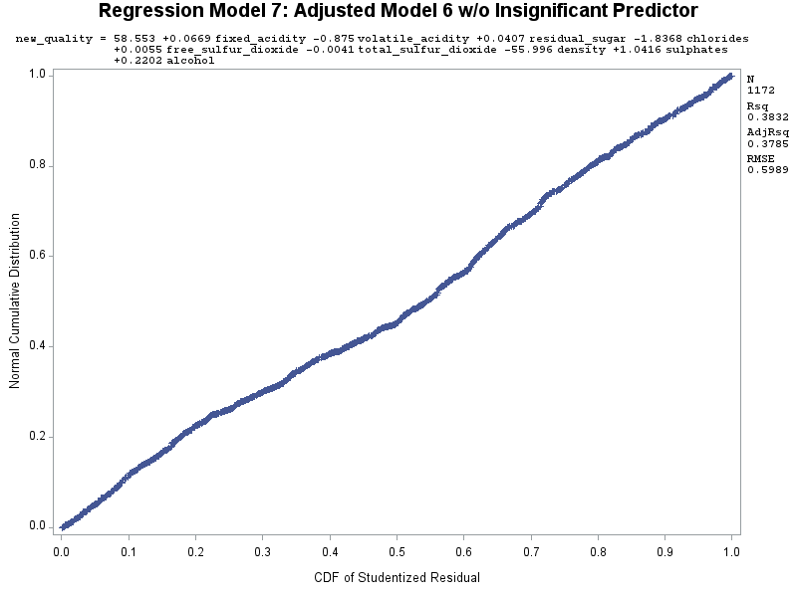

Slide 28
Analysis of Residuals for Final Model
The residual plots for the predictors appear randomly scattered, at least to me. However, I could not mend residual_sugar and chlorides, though that might be because they are in the range of low values.
The residual plot for the predicted values still appear randomly scattered.
Also, the normal probability plot has been improved as much as it can be (through my iterations of removing outliers + influential points, as well as removing two predictors).
Overall, regression model is a good fit for the data still.

Slide 29
Final Model (M7)
new_quality = 58.55277 + 0.06691*fixed_acidity – 0.87501*volatile_acidity + 0.04074*residual_sugar – 1.83678*chlorides + 0.00546*free_sulfur_dioxide – 0.00407*total_sulfur_dioxide – 55.99582*density + 1.04157*sulphates + 0.22022*alcohol
As for interpreting the coefficients,
[A positive coefficient value example]:
When fixed_acidity increases by 1 unit, wine quality increases by 0.06691.
“ ”
(Note that if the coefficient value is negative as is the case for some predictors, wine quality will decrease)
[A negative coefficient value example]:
When chlorides increases by 1 unit, wine quality decreases by 1.83678.
As for which predictors have the strongest influence on wine quality [ranked from strongest influence to weakest influence], they are:
alcohol, sulphates, volatile_acidity, total_sulfur_dioxide, fixed_acidity, density, chlorides, free_sulfur_dioxide, and residual_sugar

Slide 30
Measure of Overall Fit
We want to have:
A high R² value R² : 0.3832 → 38.32%, which we do not. It is kind of weak (almost moderate)
A high Adj R² value Adj R²: 0.3785 → 37.85%, again, which we do not. It is kind of weak (almost moderate)
A low RMSE value RMSE: 0.59885, so okay. Moderate. Predicts with half accuracy
Significant predictors (so tests on individual coefficients to determine which predictors go into the model. Predictors that have a coefficient value less than our alpha value at 0.05 are significant), which we do
A model of good fit (i.e., a “Goodness of Fit” test that helps determine if the model is good for prediction) [“Goodness of Fit” test on next slide]

Slide 31
“Goodness of Fit” Test
Test hypotheses:
Null hypothesis: None of the x-variables included in the model have any association with the y-variable
H₀: β₁ = β₂ = β₃ = … = β_{k} = 0
Alternative hypothesis: There is at least one x-variable that has a significant effect on the changes in the y-variable
H_{a}: β_{j} ≠ 0
Test statistic:
F = MSR / MSE = 28.77114 / 0.35862 = 80.2273715911 ≈ 80.23
So F ≈ 80.23 and with p-value less than 0.05 (at alpha = 0.05)
Conclusion: The F-statistic is high enough (though not the highest, being at 80.23), and the p-value associated with it is very small (less than alpha = 0.05), therefore we can reject H₀, and conclude that there is at least one predictor that has a significant effect on the changes in the y-variable, quality. So, our GOF test passes.

Slide 32
Step 5: Compute Predictions
* ---------------(5) Compute Predictions---------------;
* Compute predictions on new value;
TITLE "Compute Predictions";
* Create dataset with new value;
data pred;
input quality fixed_acidity volatile_acidity residual_sugar chlorides free_sulfur_dioxide total_sulfur_dioxide density sulphates alcohol; * Only do predictions on final model;
datalines;
. 13 0.9 5.8 0.225 20 157 0.9984 1.44 10.7
. 5.2 0.28 1.3 0.061 5 17 0.9933 0.48 9.1
;
RUN;
PROC PRINT;
RUN;
* Join/combine new dataset with original, well, edited dataset that had the removed outliers + influential points, wine_removed, since you want to use full dataset when computing predictions;
data prediction;
set pred wine_removed;
RUN;
PROC PRINT;
RUN;
* Compute regression analysis and confidence interval for average estimate;
PROC REG;
model quality = fixed_acidity volatile_acidity residual_sugar chlorides free_sulfur_dioxide total_sulfur_dioxide density sulphates alcohol / p clm cli;
RUN;

Slide 33
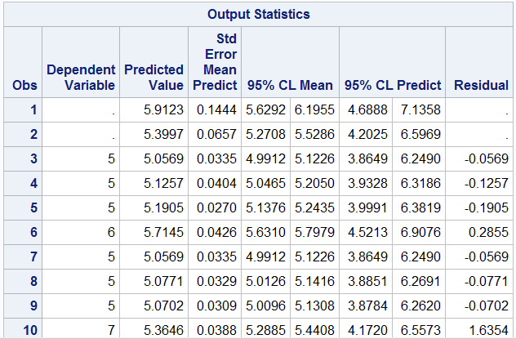
Prediction 1:
The predicted wine quality is 5.9123, with a confidence interval of 5.6292 to 6.1955, and will fall within the prediction interval of 4.6888 to 7.1358.
Prediction 2:
The predicted wine quality is 5.3997, with a confidence interval of 5.2708 to 5.5286, and will fall within the prediction interval of 4.2025 to 6.5969.

Slide 34
Step 6: Testing
* ---------------(6) Testing---------------;
* Get predicted values for the missing new_quality in test set for final model (Model 7);
TITLE "Validation - Test Set";
PROC REG data = wine2_removed;
model new_quality = fixed_acidity volatile_acidity residual_sugar chlorides free_sulfur_dioxide total_sulfur_dioxide density sulphates alcohol;
* out = outm7 defines dataset containing Model 7 predicted values for test set;
output out = outm7 (where = (new_quality =.)) p = yhat; * Predicted y for test set for M7;
RUN;
PROC PRINT data = outm7;
RUN;
* Summarize the results of the cross-validations for M7;
TITLE "Difference between Observed and Predicted in Test Set";
DATA outm7_sum;
set outm7;
d = quality - yhat; * d is the difference between observed and predicted values in test set;
absd = abs(d);
RUN;
* Compute predictive statistics: root mean square error (rmse) and mean absolute error (mae);
PROC SUMMARY data = outm7_sum;
var d absd;
output out = outm7_stats std(d) = rmse mean(absd) = mae; * These two are the performance stats (RMSE and MAE);
RUN;
PROC PRINT data = outm7_stats;
TITLE "Validation Statistics for Model";
RUN;
* Compute correlation of observed and predicted values in test set;
PROC CORR data = outm7;
var quality yhat; * This computes R value for test set, which we will use this value to compute for R^2 value and CV R^2 value;
RUN;

Slide 35
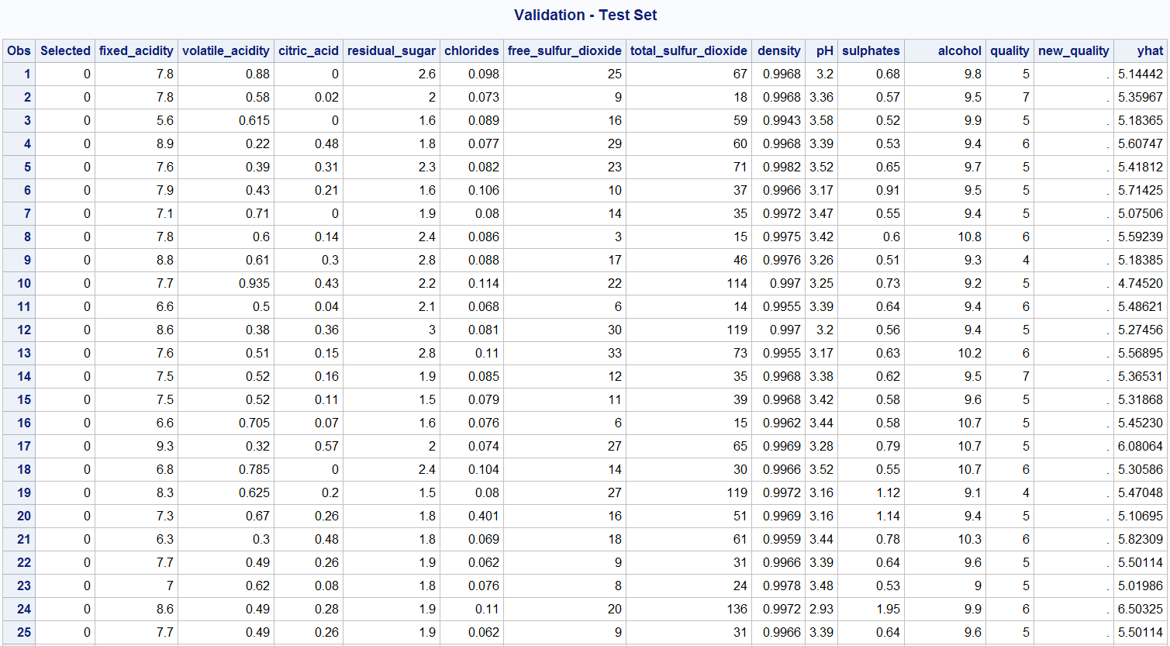

Slide 36
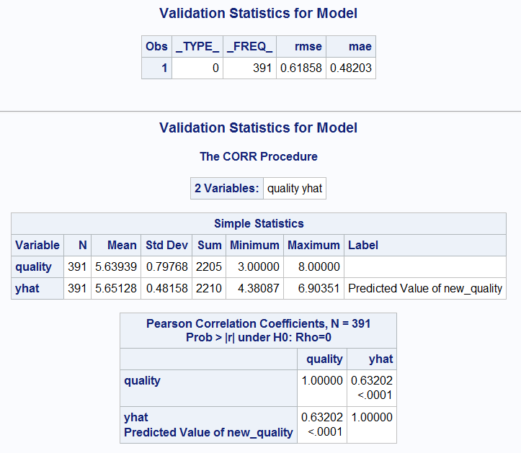

Slide 37
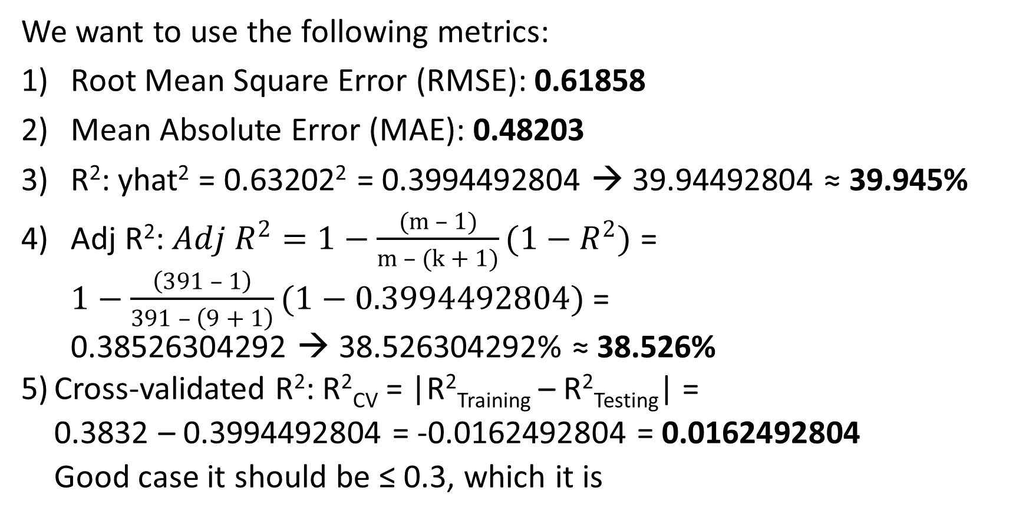
Assessing Test Performance of Testing Set (i.e., measuring predictive performance, which is part of model validation)
We want to use the following metrics:
Root Mean Square Error (RMSE): 0.61858
Mean Absolute Error (MAE): 0.48203
R²: yhat² = 0.63202² = 0.3994492804 → 39.94492804 ≈ 39.945%
Adj R²: $Adj R^{2}=1−\frac{(m – 1)}{m – (k + 1)}(1−R^{2})$ = $1−\frac{\left(391 – 1\right)}{391 – \left(9 + 1\right)}(1−0.3994492804)$ = 0.38526304292 → 38.526304292% ≈ 38.526%
Cross-validated R²: R²_{CV} = |R²_{Training} – R²_{Testing}| = 0.3832 – 0.3994492804 = -0.0162492804 = 0.0162492804 Good case it should be ≤ 0.3, which it is

